Slide 1

Virtualization in cloud computing
By
Mr. Saurabh Singhal
Assistant Professor
Department of Computer Engineering & Applications
GLA University

Slide 2
Introduction
Virtualization technology is one of the fundamental components of cloud computing, especially in regard to infrastructure-based services.
Virtualization allows the creation of a secure, customizable, and isolated execution environment for running applications, even if they are untrusted, without affecting other users’ applications.
The basis of this technology is the ability of a computer program—or a combination of software and hardware—to emulate an executing environment separate from the one that hosts.

Slide 3
Introduction
Virtualization provides a great opportunity to build elastically scalable systems that can provision additional capability with minimum costs.
Virtualization is widely used to deliver customizable computing environments on demand.
Virtualization technologies provide a virtual environment for not only executing applications but also for storage, memory, and networking.

Slide 4
Reasons for the growth of Virtualization
Increased performance and computing capacity
Underutilized hardware and software resources
Lack of space
Greening initiatives
Rise of administrative costs {Disadvantageous}

Slide 5
Characteristics of virtualized environments
In a virtualized environment there are three major components:
Guest
Host
Virtualization layer

Slide 6
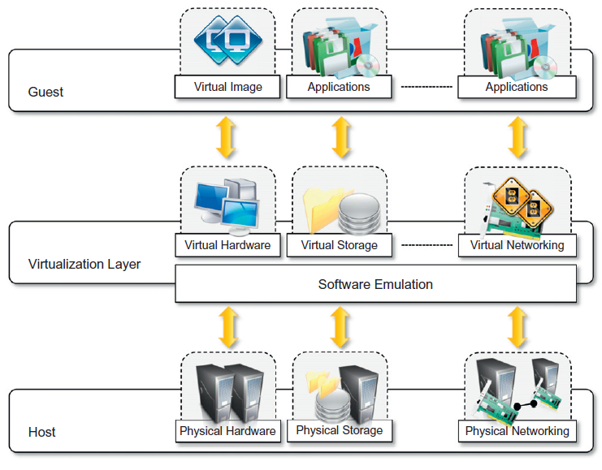
The virtualization reference model

Slide 7
The virtualization reference model - Guest
The guest represents the system component that interacts with the virtualization layer rather than with the host, as would normally happen.
The guest— applications and users—interacts with a virtual network, such as a virtual private network(VPN), which is managed by specific software (VPNclient) using the physical network available on the node.
VPNs are useful for creating the illusion of being with in a different physical network and thus accessing the resources in it, which would otherwise not be available.

Slide 8
The virtualization reference model - Host
The host represents the original environment where the guest is supposed to be managed.
The host is instead represented by the physical hardware, and in some cases the operating system, that defines the environment where the virtual machine manager is running.
In the case of virtual storage, the guest might be client applications or users that interact with the virtual storage management software deployed on top of the real storage system.

Slide 9
The virtualization reference model – Virtualization Layer
The virtualization layer is responsible for recreating the same or a different environment where the guest will operate

Slide 10
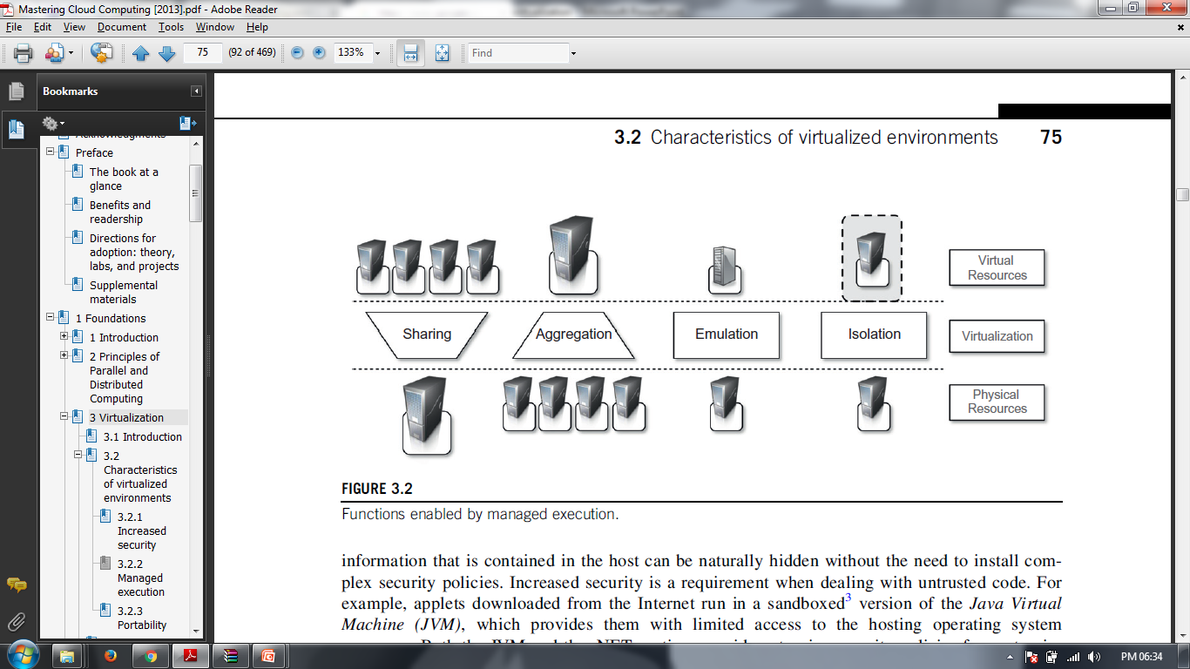
Advantages of Virtualization
Increased security
Performance tuning
Portability
Managed execution
Sharing
Aggregation
Emulation
Isolation

Slide 11
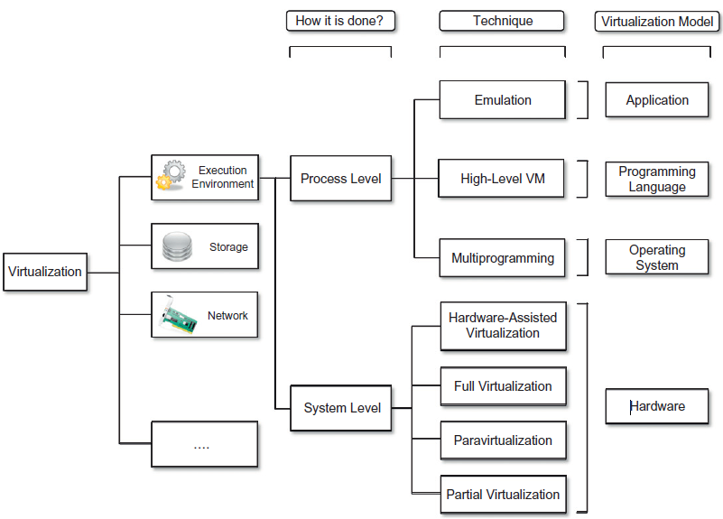
A Taxonomy of Virtualization Techniques

Slide 12
A Taxonomy of Virtualization Techniques-Execution virtualization
Execution virtualization includes all techniques that aim to emulate an execution environment that is separate from the one hosting the virtualization layer.
All these techniques concentrate their interest on providing support for the execution of programs
Therefore, execution virtualization can be implemented directly on top of the hardware by the operating system.

Slide 13
A Taxonomy of Virtualization Techniques
Process Level
It provides the ability to the main computer to run and create one or more virtual environments. It is used to enable a complete computer system in order to allow a guest OS to run. For instance letting Linux to run as a guest that is natively running a Microsoft Windows OS (or vice versa, running Windows as a guest on Linux).
Types:
Operating system
Application virtualization
Programming Language

Slide 14
A Taxonomy of Virtualization Techniques
Hardware virtualization
It is the most common type of virtualization as it provides advantages of hardware utilization and application uptime.
The basic idea of the technology is to combine many small physical servers into one large physical server
The operating system that is running on a physical server gets converted into a well-defined OS that runs on the virtual machine.
The hypervisor controls the processor, memory, and other components by allowing different OS to run on the same machine without the need for a source code.

Slide 15
A Taxonomy of Virtualization Techniques
Emulation
VM emulates/simulates complete hardware
Unmodified guest OS for a different PC can be run
Bochs, VirtualPC for Mac, QEMU
OS-level virtualization
OS allows multiple secure virtual servers to be run
Guest OS is the same as the host OS, but appears isolated
Apps see an isolated OS – Solaris Containers, BSD Jails, Linux Vserver

Slide 16
A Taxonomy of Virtualization Techniques
Application level virtualization
Application is gives its own copy of components that are not shared
E.g., own registry files, global objects
VE prevents conflicts
JVM

Slide 17
A Taxonomy of Virtualization Techniques
Hardware virtualization
Full Virtualization – In it, the complete simulation of the actual hardware takes place to allow software to run an unmodified guest OS.
Para Virtualization – In this type of virtualization, software unmodified runs in modified OS as a separate system.
Partial Virtualization – In this type of hardware virtualization, the software may need modification to run

Slide 18
A Taxonomy of Virtualization Techniques
Para-virtualization
VM does not simulate hardware
Use special API that a modified guest OS must use
Hypercalls trapped by the Hypervisor and serviced – Xen, VMWare ESX Server
Full/native Virtualization
VM simulates “enough” hardware to allow an unmodified guest OS to be run in isolation
Same hardware CPU – IBM VM family, VMWare Workstation, Parallels

Slide 19
Machine reference model
Virtualizing is an execution environment at different levels of the computing stack requires a reference model that defines the interfaces between the levels of abstractions, which hide implementation details.
From this perspective, virtualization techniques actually replace one of the layers and intercept the calls that are directed toward it.
Therefore, a clear separation between layers simplifies their implementation, which only requires the emulation of the interfaces and a proper interaction with the underlying layer.

Slide 20
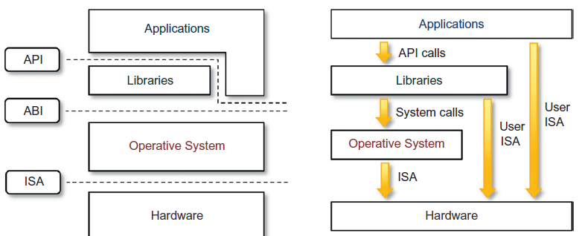
Machine reference model
Instruction Set Architecture (ISA) : which defines the instruction set for the processor, registers, memory, and interrupt management
Application Binary Interface (ABI) : separates the operating system layer from the applications and libraries, which are managed by the OS. ABI covers details such as low-level data types, alignment, and call conventions and defines a format for executable programs

Slide 21
Hardware-level virtualization
Hardware-level virtualization is a virtualization technique that provides an abstract execution environment in terms of computer hardware on top of which a guest operating system can be run.
In this model, the guest is represented by the operating system, the host by the physical computer hardware, the virtual machine by its emulation, and the virtual machine manager by the hypervisor
Hardware-level virtualization is also called system virtualization, since it provides ISA to virtual machines, which is the representation of the hardware interface of a system.
This is to differentiate it from process virtual machines, which expose ABI to virtual machines

Slide 22
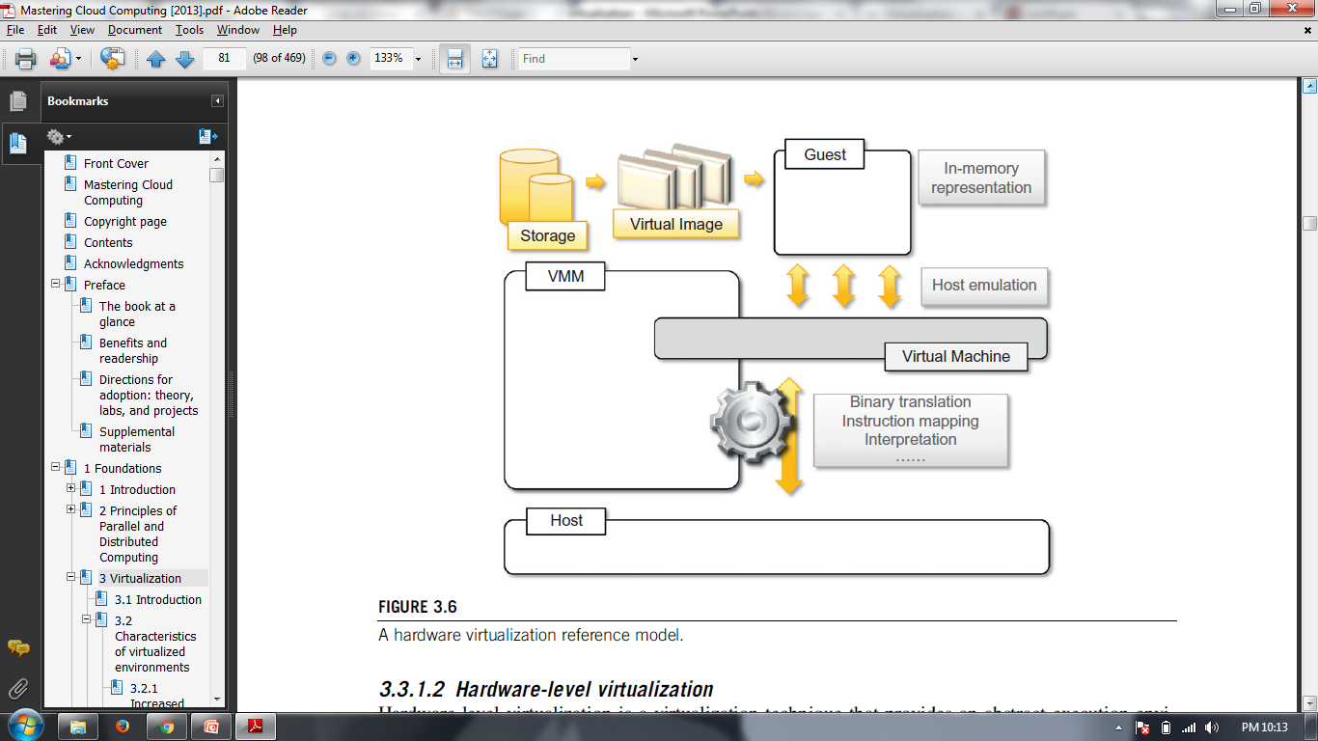
Hardware-level virtualization

Slide 23
Hypervisors
The hypervisor is generally a program or a combination of software and hardware that allows the abstraction of the underlying physical hardware.
A fundamental element of hardware virtualization is the hypervisor, or virtual machine manager (VMM).
It recreates a hardware environment in which guest operating systems are installed.
There are two major types of hypervisor:
Type I
Type II

Slide 24
Hypervisors
Type I hypervisors run directly on top of the hardware.
Therefore, they take the place of the operating systems and interact directly with the ISA interface exposed by the underlying hardware, and they emulate this interface in order to allow the management of guest operating systems.
This type of hypervisor is also called a native virtual machine since it runs natively on hardware.
Type II hypervisors require the support of an operating system to provide virtualization services.
This means that they are programs managed by the operating system, which interact with it through the ABI and emulate the ISA of virtual hardware for guest operating systems.
This type of hypervisor is also called a hosted virtual machine since it is hosted within an operating system

Slide 25
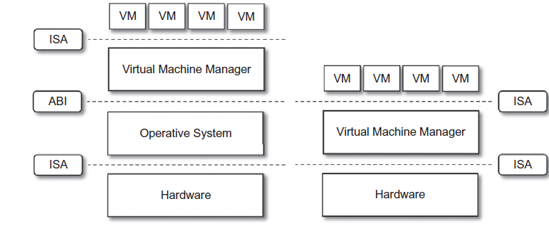
Hypervisors
Type II Type I

Slide 26
A Hypervisor Reference Architecture
The design and architecture of a virtual machine manager, together with the underlying hardware design of the host machine, determine the full realization of hardware virtualization, where a guest operating system can be transparently executed on top of a VMM as though it were run on the underlying hardware.
The criteria that need to be met by a virtual machine manager to efficiently support virtualization were established by Goldberg and Popek in 1974. For that, three properties have to be satisfied:
Equivalence
Resource control
Efficiency

Slide 27
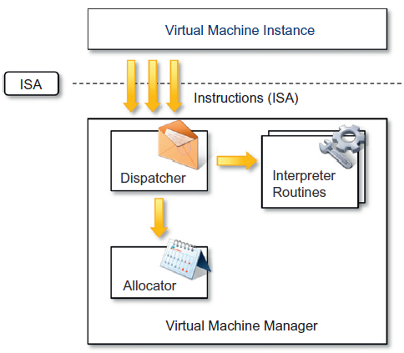
A Hypervisor Reference Architecture

Slide 28
A Hypervisor Reference Architecture
The dispatcher constitutes the entry point of the monitor and reroutes the instructions issued by the virtual machine instance to one of the two other modules.
The allocator is responsible for deciding the system resources to be provided to the VM: whenever a virtual machine tries to execute an instruction that results in changing the machine resources associated with that VM, the allocator is invoked by the dispatcher.
The interpreter module consists of interpreter routines.
These are executed whenever a virtual machine executes a privileged instruction: a trap is triggered and the corresponding routine is executed

Slide 29
Hardware Virtualization Techniques
Hardware-assisted virtualization:
This term refers to a scenario in which the hardware provides architectural support for building a virtual machine manager able to run a guest operating system in complete isolation.
Paravirtualization
This techniques expose a software interface to the virtual machine that is slightly modified from the host and, as a consequence, guests need to be modified. The aim of paravirtualization is to provide the capability to demand the execution of performance-critical operations directly on the host, thus preventing performance losses that would otherwise be experienced in managed execution

Slide 30
Hardware Virtualization Techniques
Partial virtualization:
Partial virtualization provides a partial emulation of the underlying hard- ware, thus not allowing the complete execution of the guest operating system in complete isolation. Partial virtualization allows many applications to run transparently, but not all the features of the operating system can be supported, as happens with full virtualization

Slide 31
Operating System-level Virtualization
Operating system-level virtualization offers the opportunity to create different and separated execution environments for applications that are managed concurrently.
Differently from hardware virtualization, there is no virtual machine manager or hypervisor, and the virtualization is done within a single operating system, where the OS kernel allows for multiple isolated user space instances.
The kernel is also responsible for sharing the system resources among instances and for limiting the impact of instances on each other

Slide 32
Programming Language-level Virtualization
Programming language-level virtualization is mostly used to achieve ease of deployment of applications, managed execution, and portability across different platforms and operating systems.
It consists of a virtual machine executing the byte code of a program, which is the result of the compilation process.
Compilers implemented and used this technology to produce a binary format representing the machine code for an abstract architecture.
The characteristics of this architecture vary from implementation to implementation.

Slide 33
Application-level Virtualization
Application-level virtualization is a technique allowing applications to be run in runtime environments that do not natively support all the features required by such applications.
In this scenario, applications are not installed in the expected runtime environment but are run as though they were.
In general, these techniques are mostly concerned with partial file systems, libraries, and operating system component emulation

Slide 34
Other Types Of Virtualization
Storage virtualization
Storage virtualization is a system administration practice that allows decoupling the physical organization of the hardware from its logical representation
Using this technique, users do not have to be worried about the specific location of their data, which can be identified using a logical path
Storage virtualization allows users to harness a wide range of storage facilities and represent them under a single logical file system.
Ex: Storage area networks (SANs).

Slide 35
Other Types Of Virtualization
Network virtualization
Network virtualization combines hardware appliances and specific software for the creation and management of a virtual network.
It can aggregate different physical networks into a single logical network or provide network-like functionality to an operating system partition/
The result of external network virtualization is generally a virtual LAN(VLAN).
For internal virtualization: The guest can share the same network interface of the host and use Network Address Translation (NAT).

Slide 36
Other Types Of Virtualization
Desktop virtualization
Desktop virtualization abstracts the desktop environment available on a personal computer in order to provide access to it using a client/server approach.
Desktop virtualization provides the same outcome of hardware virtualization but serves a different purpose.
Desktop virtualization addresses the problem of making the same desktop environment accessible from everywhere.

Slide 37
Other Types Of Virtualization
Application server virtualization
Application server virtualization abstracts a collection of application servers that provide the same services as a single virtual application server by using load balancing strategies and providing a high-availability infrastructure for the services hosted in the application server.
This is a particular form of virtualization and serves the same purpose of storage virtualization: providing a better quality of service rather than emulating a different environment

Slide 38
Virtualization And Cloud Computing
??

Slide 39
Pros And Cons Of Virtualization
Advantages of virtualization
Managed execution
Isolation
Portability
Reduce costs of maintenance
More efficient use of resources
Reduction in energy consumption

Slide 40
Pros And Cons Of Virtualization
Disadvantages of virtualization
Performance degradation
Inefficiency and degraded user experience
Security holes

Slide 41
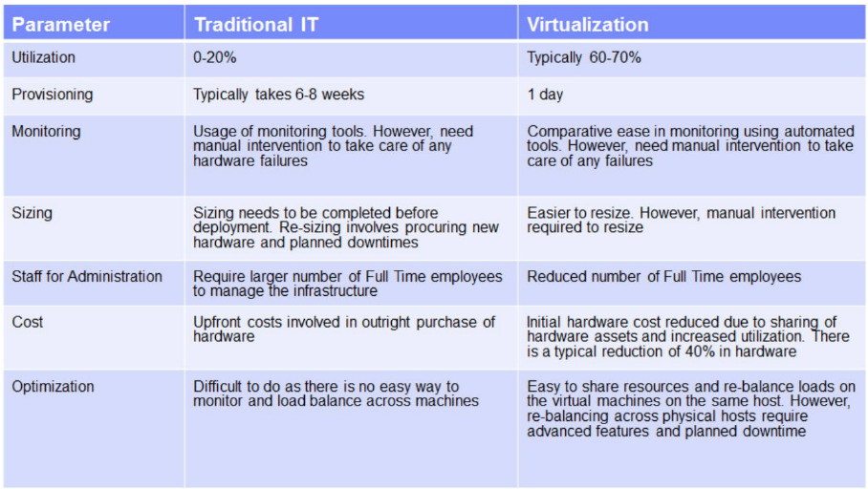
What virtualization offers ?

Slide 42
 | Virtualization | Cloud
Definition | Technology | Methodology
Purpose | Create multiple simulated environments from 1 physical hardware system | Pool and automate virtual resources for on-demand use
Use | Deliver packaged resources to specific users for a specific purpose | Deliver variable resources to groups of users for a variety of purposes
Configuration | Image-based | Template-based
Lifespan | Years (long-term) | Hours to months (short-term)
Cost | High capital expenditures (CAPEX), low operating expenses (OPEX) | Private cloud: High CAPEX, low OPEX Public cloud: Low CAPEX, high OPEX
Scalability | Scale up | Scale out
Workload | Stateful | Stateless
Tenancy | Single tenant | Multiple tenants

